Slide 1
CS2040S Tutorial 1
Done by Xiao Yan

Slide 2
About me
Name: Xiao Yan
Course: Y2 Computer Science
Hobbies: Competitive Programming, Badminton, Basketball
Contacts: e0902032@u.nus.edu
Telegram: @XpeterY007

Slide 3
About You
Name
Planned Focus Area
Why CS?
CCAs / interesting thing about yourself
How difficult did you find ps1/ps2 out of 10
Have you taken trinity(CS2030S, CS2040S, CS2100)? Why?

Slide 4
Admin Matters

Slide 5
Structure of Tutorials
Starting from next week, send me your answers to your assigned questions in a pdf before the tutorial via Telegram (for preparedness points)
Don’t need to do everything; just go through the questions and do what you can!
During the tutorials, I’ll call on you guys to answer to questions in an order I’ll publish days before tutorial on Telegram (so you’ll be prepared to answer at least one question! And everybody gets to answer for participation marks)
You are encouraged to give alternative solutions/add on for more participation points

Slide 6
Structure of Tutorials
Gives you at least one question to think deeply about and answer
Expectations : No need to do everything in the tutorial beforehand, just get a rough idea of the questions and be prepared to answer questions assigned to you in class
Discussion are warmly welcome

Slide 7
Structure of Tutorials
EXP during tutorials will be based on:
Preparedness XP (effort put into the answers you send me before the tutorial)
Participation XP (how much you are willing to engage with the class and contribute)
Attendance XP (whether you come to tutorial)
Notes:
Some people might be too shy to speak up in class, so preparedness xp tells me whether you actually did the tutorial so I can award xp accordingly

Slide 8
General
Communication by Telegram (group chat as much as possible so that everyone can learn! Try not to PM me directly unless it’s something private)
Consultation by appointment
I’ll try to reply to questions as soon as possible. If you don’t get some form of reply after a day, do ping me again
I’ll try to keep it to short and give you more time for Q&A or other events.

Slide 9
Grading
From PS3 onwards: NO resubmissions allowed once submitted
For fairness and to discourage “whacking” the problem until you get a good result
Can ask me to verify things related to PS, but no answers provided.
Optional Practices are exempt from this
Just add a comment on Coursemology or message me on Telegram if you wish to retry
Note that passing the public test cases does not guarantee that your solution is correct
There are private test cases which are not shown to you
I read each and every line of your code and try to come up with my own test cases that break your code even if you pass the private test cases
Test your code thoroughly!!!

Slide 10
TUTORIAL SHEET

Slide 11
Problem 1: Java Review
What is the difference between a class and an object?

Slide 12
Problem 1: Java Review
What is the difference between a class and an object?
A class is a template for objects. It defines the properties and behaviour (methods) of objects that are created from it.
On the other hand, an object is a specific instance of a class.

Slide 13
Problem 1: Java Review
Why does the main method come with a static modifier?

Slide 14
Problem 1: Java Review
Why does the main method come with a static modifier?
The static keyword allows the main method to be called without first creating an object of the class in which the main method is defined.
Static variables/methods are tied to class, rather than specific instances (objects).
Note that the following exact method signature must be used for the entry point of the program.
public static void main(String[] args)

Slide 15
Problem 1: Java Review
Give an example class (or classes) that uses the modifier private incorrectly (i.e., the program will not compile as it is, but would compile if private were changed to public).

Slide 16
Problem 1: Java Review
class SecretHolder {
private int secret;
public SecretHolder(int value){
this.secret = value;
}
}
class Test {
public static void main(String[] args){
SecretHolder holder = new SecretHolder(5);
holder.secret = 6; // Compile-time error!
}

Slide 17
Problem 1: Java Review
Why do we use interfaces?

Slide 18
Problem 1: Java Review
Why do we use interfaces?
Interfaces can be seen as a sort of “contract” that is signed by a class whenever it implements the interface.
This is helpful because we are guaranteed that classes which implement a particular interface, support the operations specified by that interface.
Notes:
Shape getArea example

Slide 19
Problem 1: Java Review
Give an example of using an interface.

Slide 20
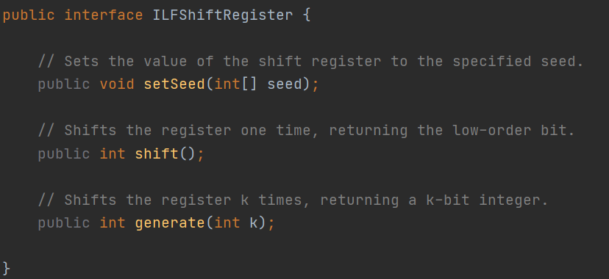
Problem 1: Java Review
Give an example of using an interface.

Slide 21
Problem 1: Java Review
Can a method return an interface?

Slide 22
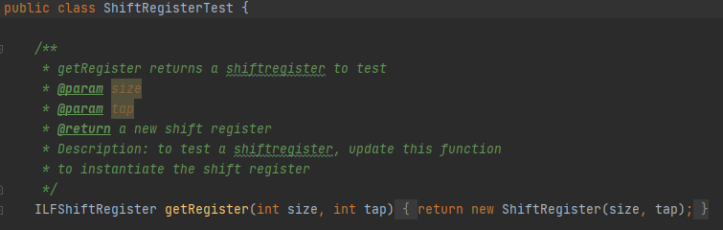
Problem 1: Java Review
Can a method return an interface?
Yes.

Slide 23
Problem 1: Java Review
Refer to IntegerExamination.java. Without running the code, predict the output of the main method. Can you explain the outputs.

Slide 24
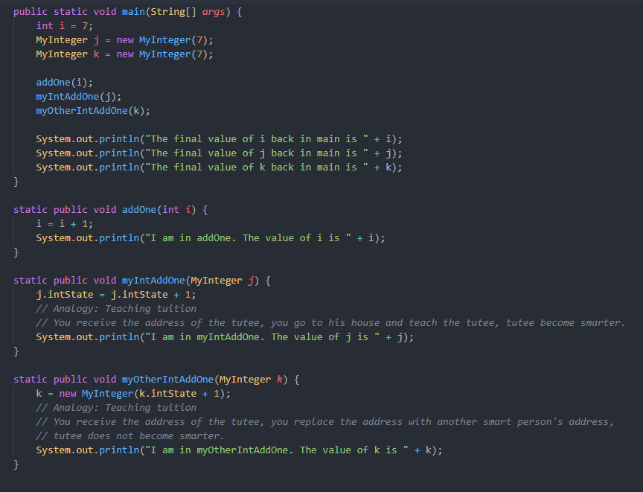

Slide 25
Problem 1: Java Review
I am in addOne. The value of i is 8
I am in myIntAddOne. The value of j is 8
I am in myOtherIntAddOne. The value of k is 8
The final value of i back in main is 7
The final value of j back in main is 8
The final value of k back in main is 7

Slide 26
Problem 1: Java Review
Can a variable in a parameter list for a method have the same name as a member (or static) variable in the class? If yes, how is the conflict of names resolved?

Slide 27
Problem 1: Java Review
Can a variable in a parameter list for a method have the same name as a member (or static) variable in the class? If yes, how is the conflict of names resolved?
Yes! Use the this keyword.

Slide 28
Big O Notation
A brief recap

Slide 29
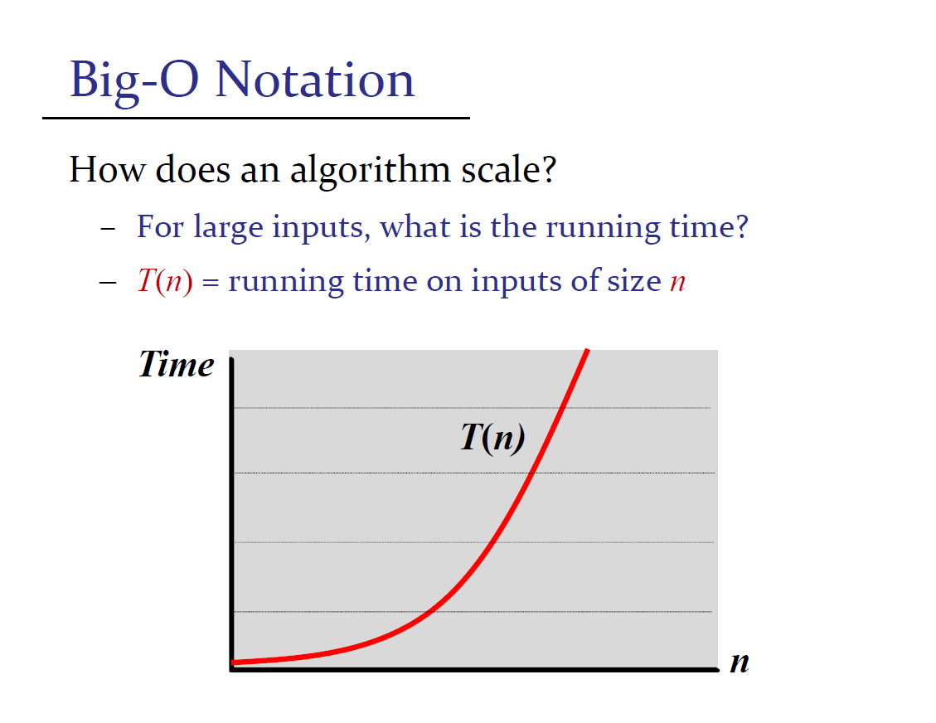
Notes:
From the CS2040S lecture slides

Slide 30
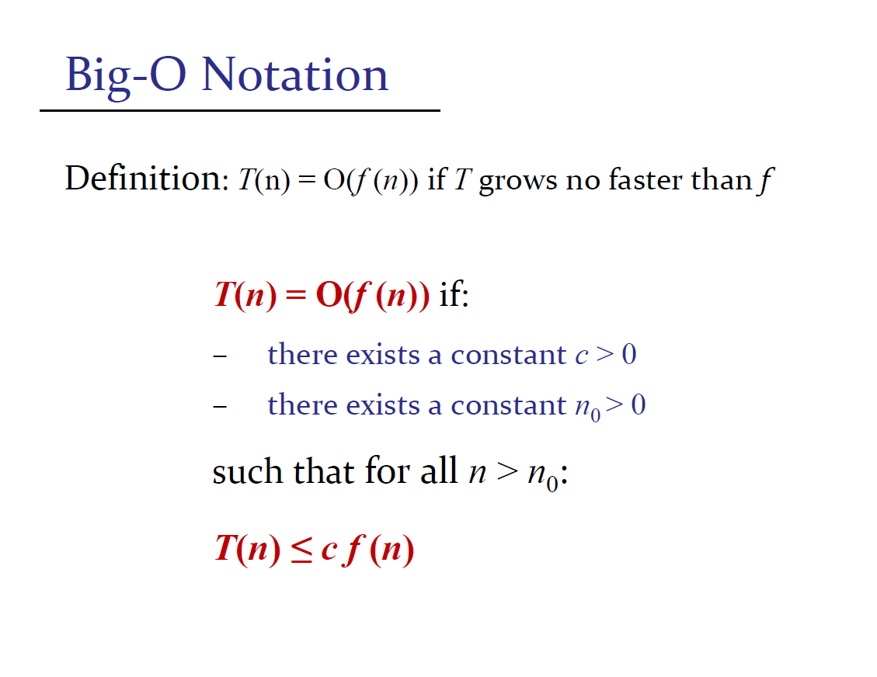
Notes:
From the CS2040S lecture slides

Slide 31
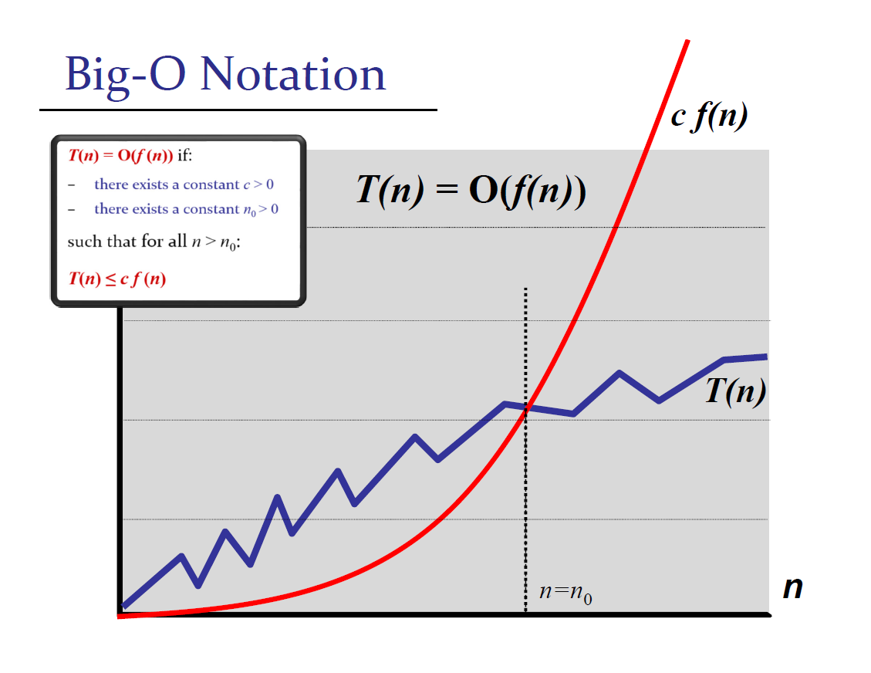
Eg(T(n) = O/Ω/Θ(f(n))
Upper bound O
T(n) <= c * f(n)
Lower bound Ω
T(n) >= c * f(n)
‘Tight’ bound Θ (doesn’t always exist)
T(n) = Θ(f(n))
iif T(n) = O(f(n)) && T(n) = Ω(f(n))
Notes:
From the CS2040S lecture slides big OMEGA

Slide 32
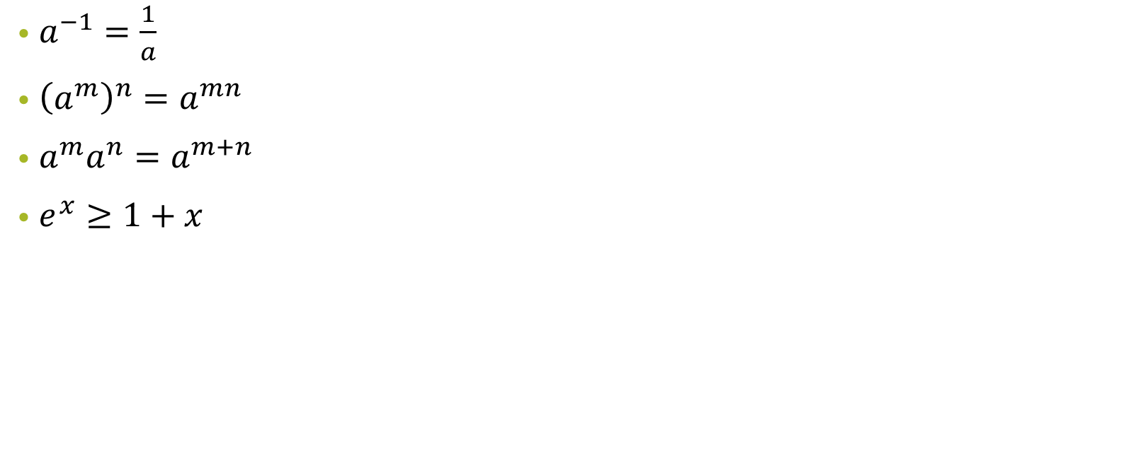
Useful Facts

Slide 33
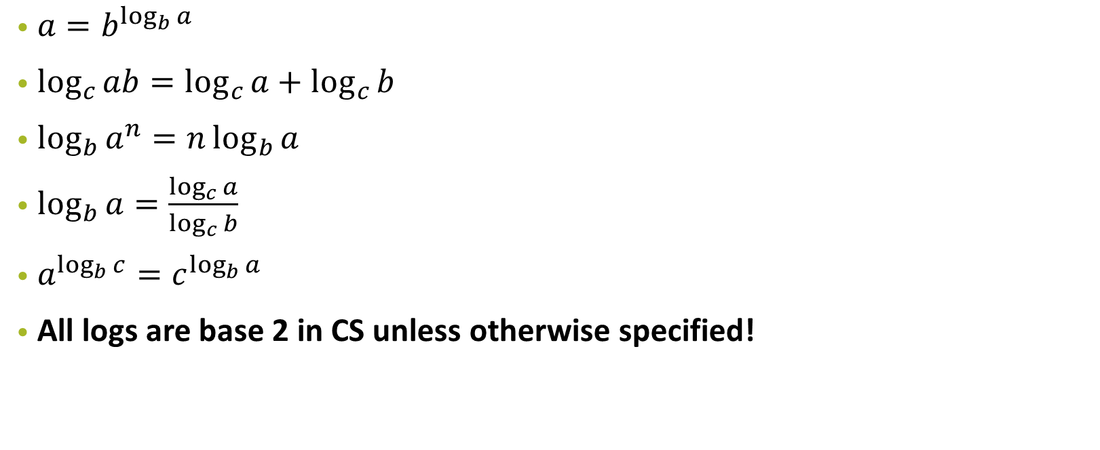
Useful Facts

Slide 34
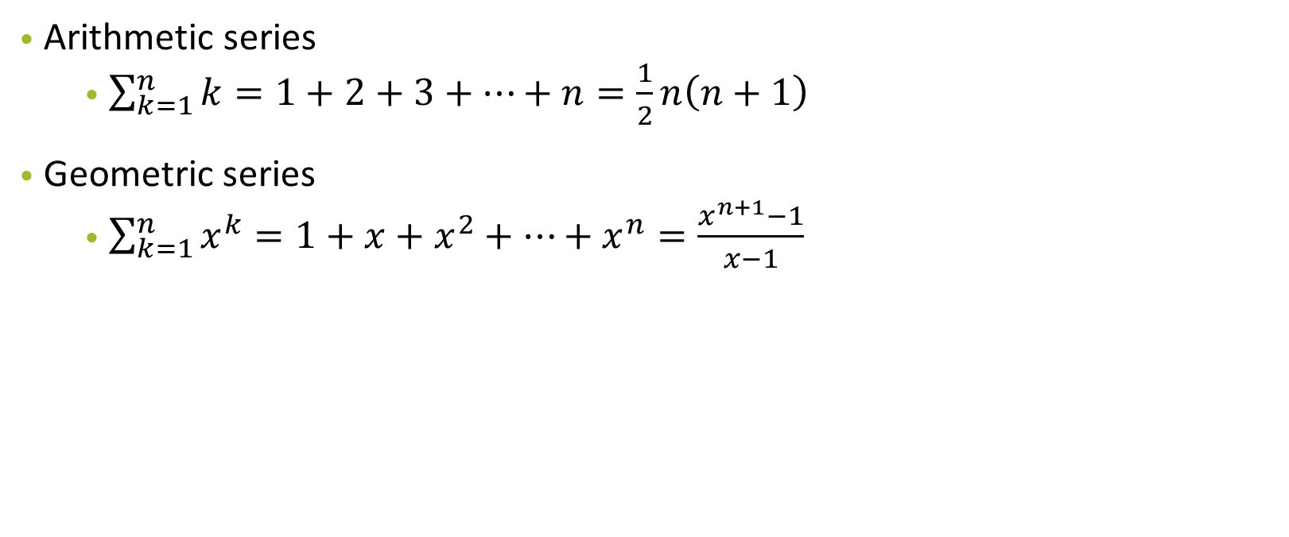
Useful Facts

Slide 35
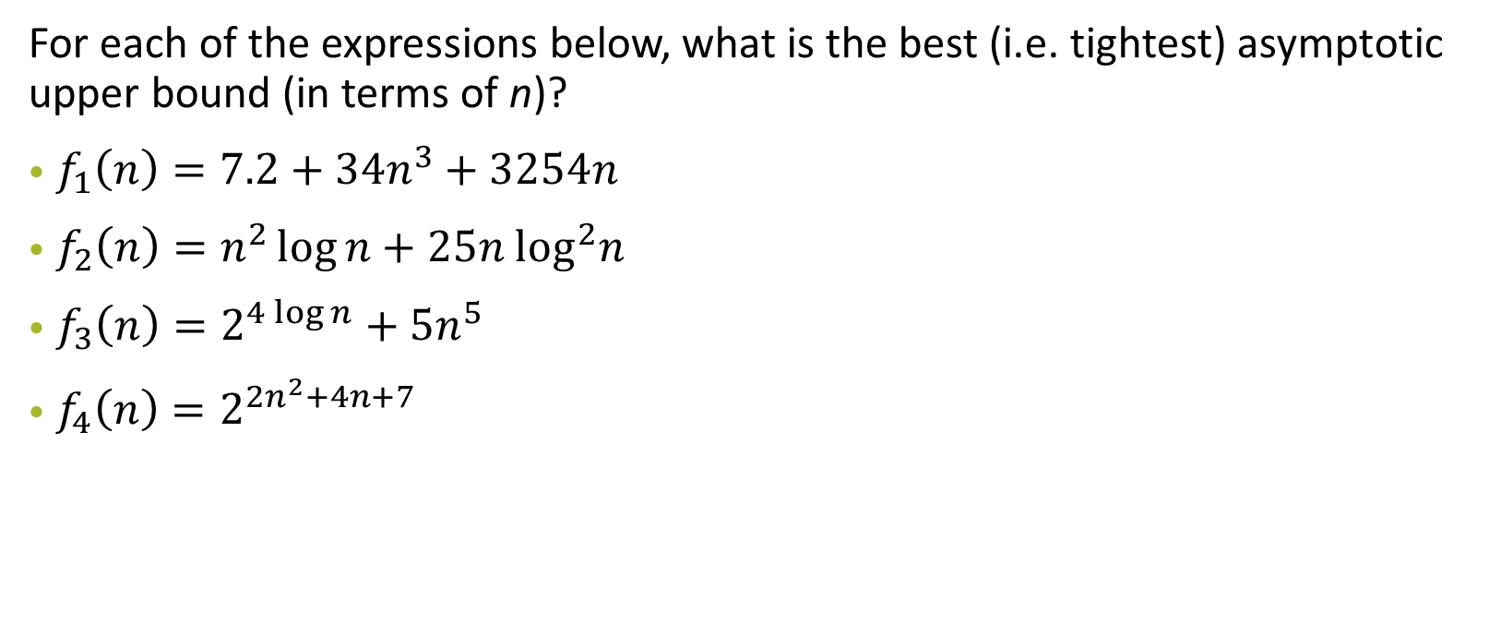
Problem 2: Asymptotic Analysis

Slide 36
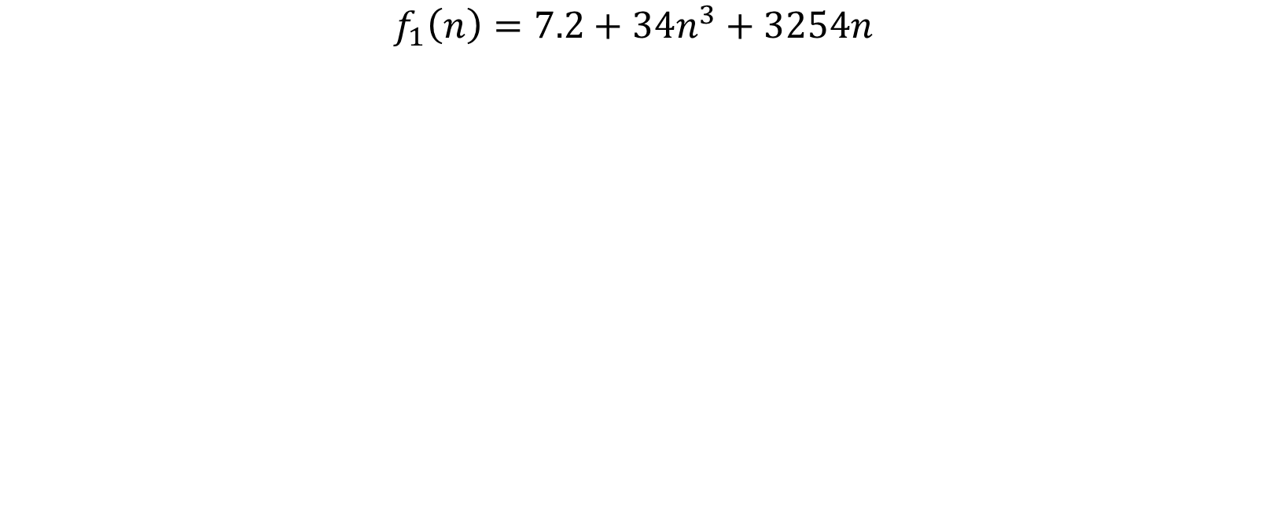
Problem 2: Asymptotic Analysis

Slide 37
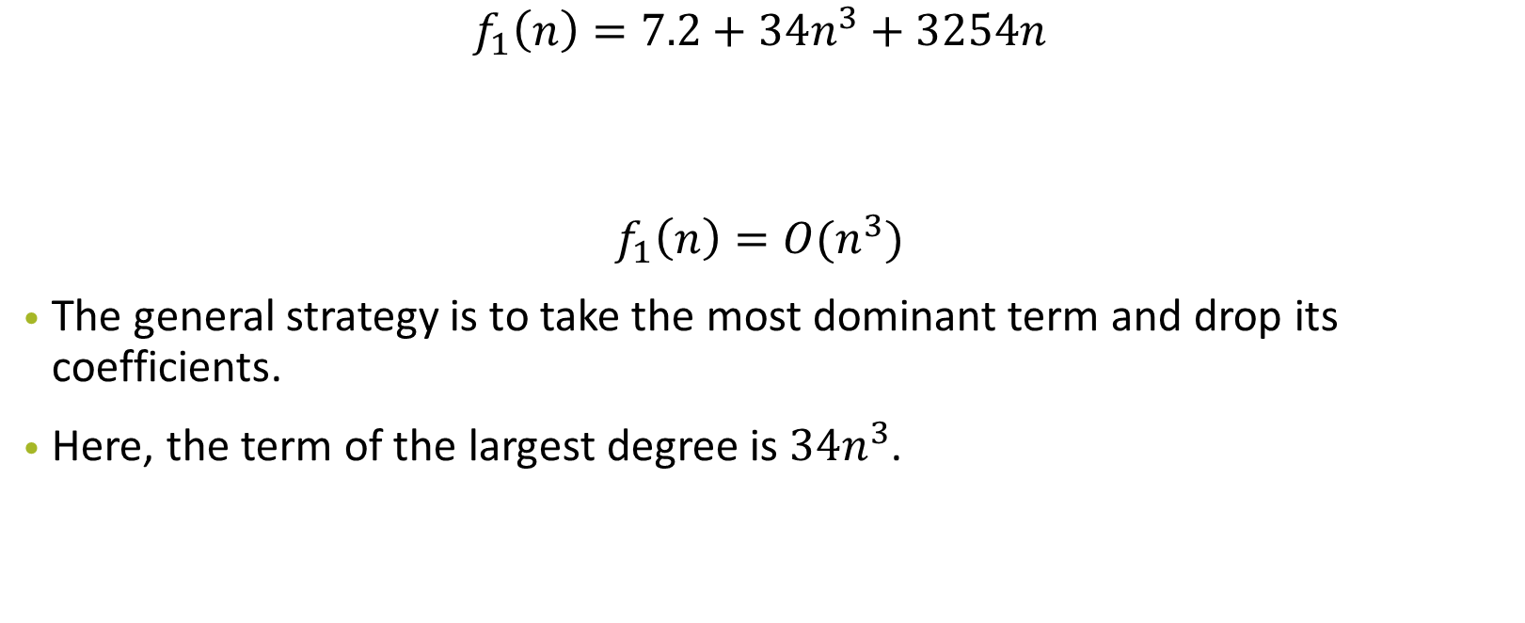
Problem 2: Asymptotic Analysis

Slide 38
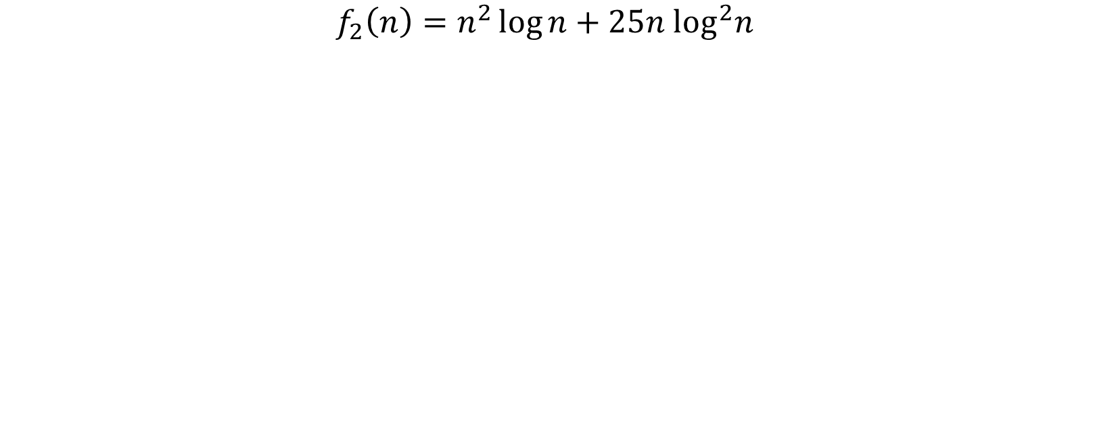
Problem 2: Asymptotic Analysis

Slide 39
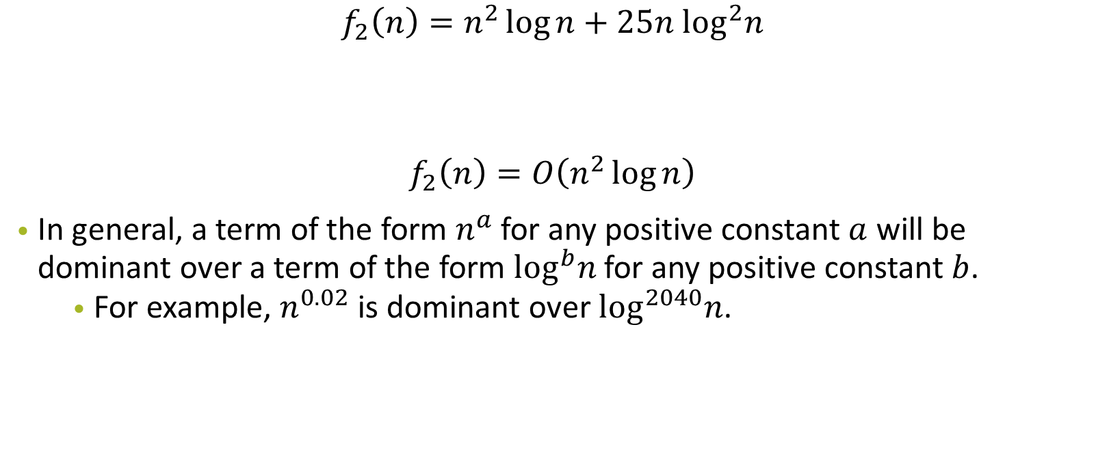
Problem 2: Asymptotic Analysis

Slide 40
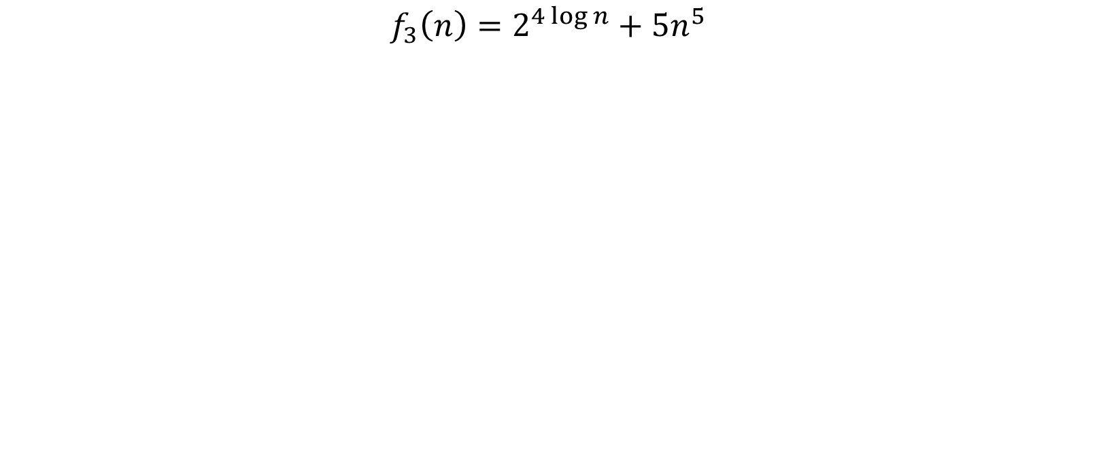
Problem 2: Asymptotic Analysis

Slide 41
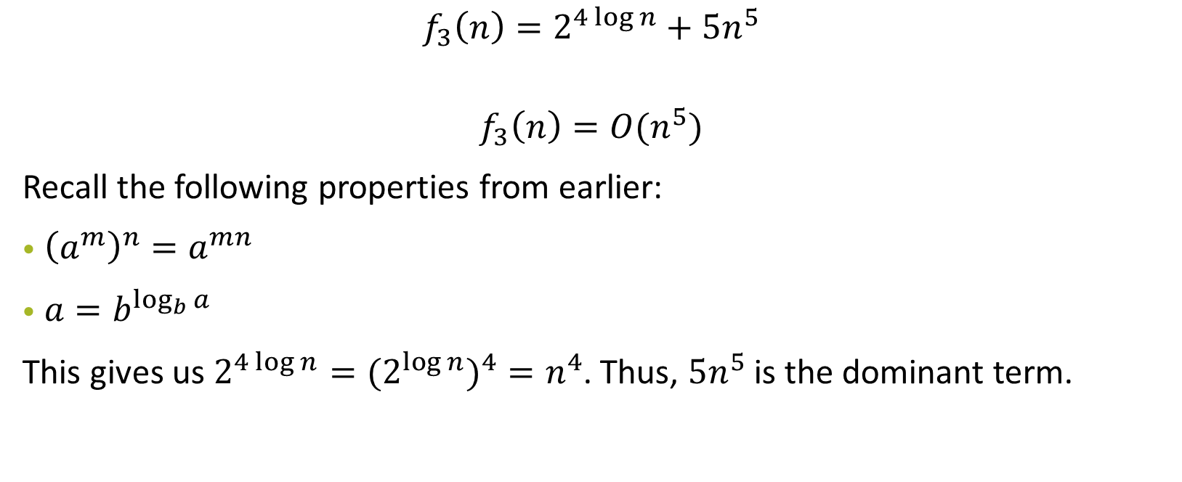
Problem 2: Asymptotic Analysis

Slide 42
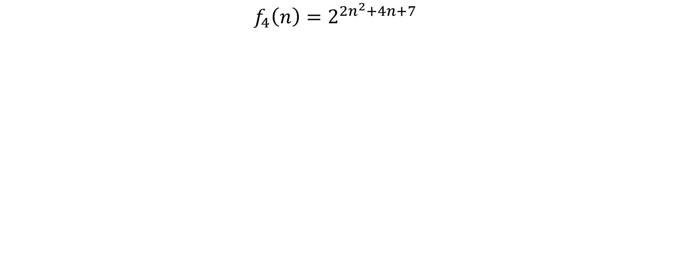
Problem 2: Asymptotic Analysis

Slide 43
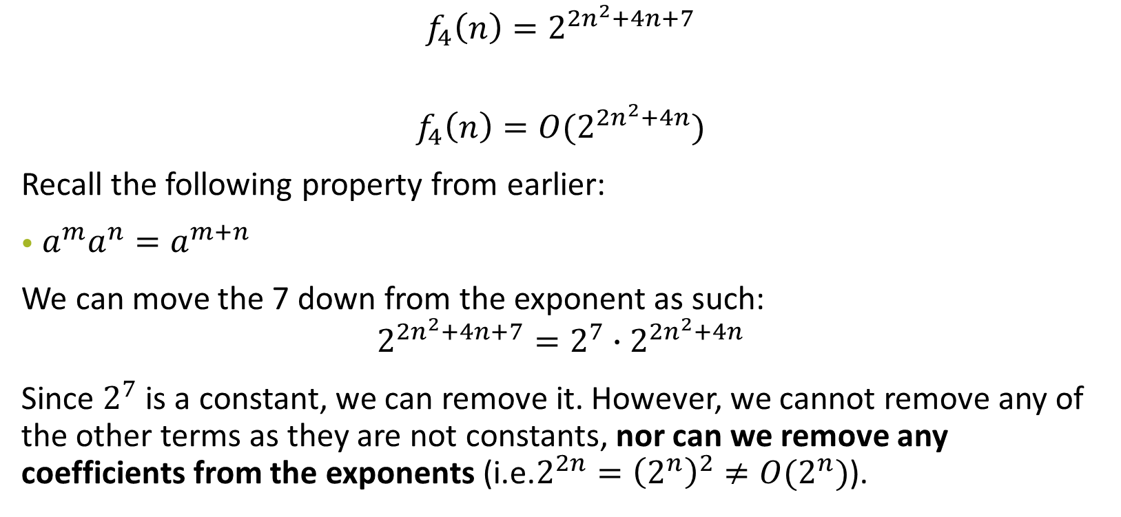
Problem 2: Asymptotic Analysis

Slide 44
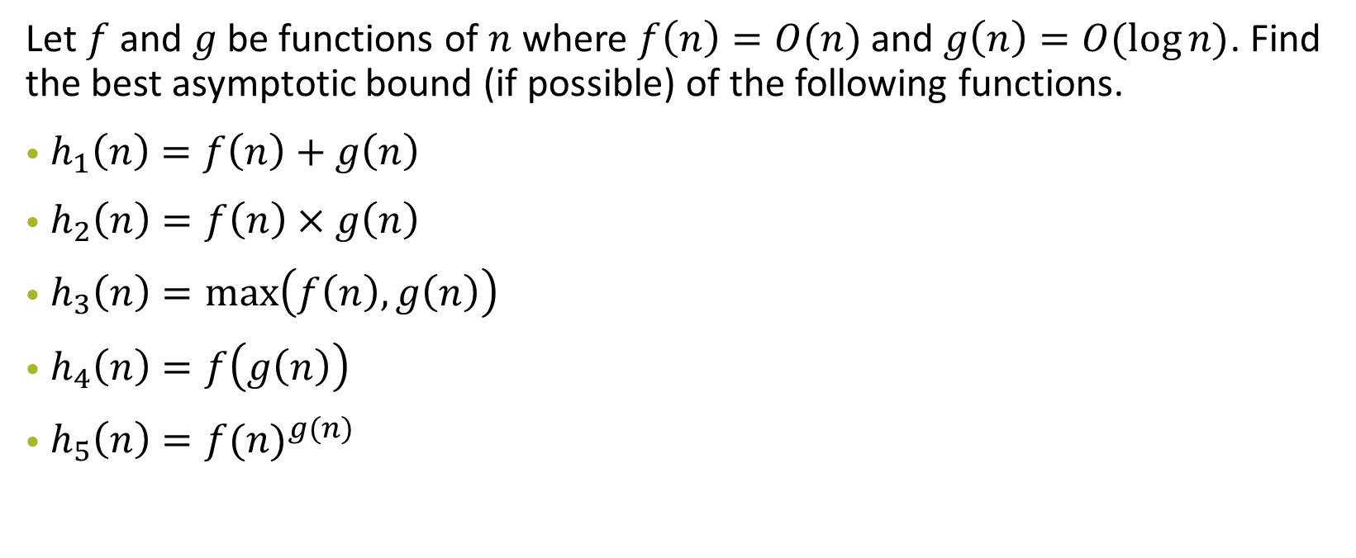
Problem 3: More Asymptotic Analysis!

Slide 45
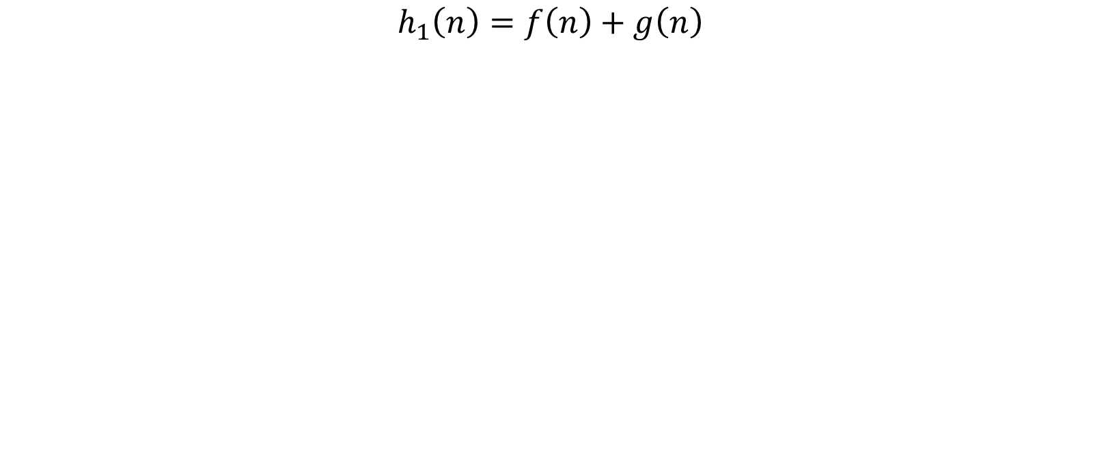
Problem 3: More Asymptotic Analysis!

Slide 46
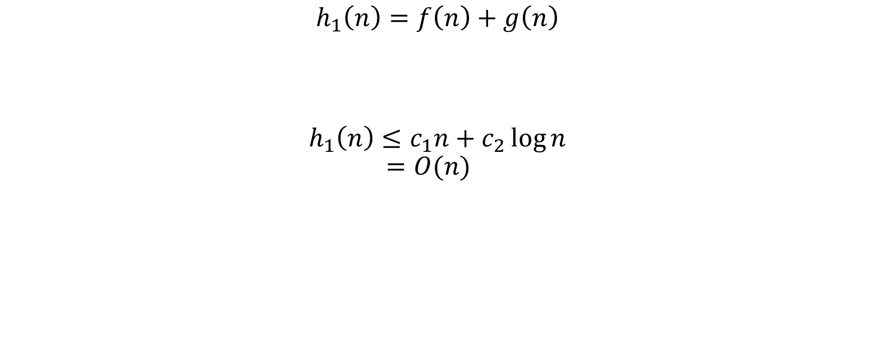
Problem 3: More Asymptotic Analysis!

Slide 47
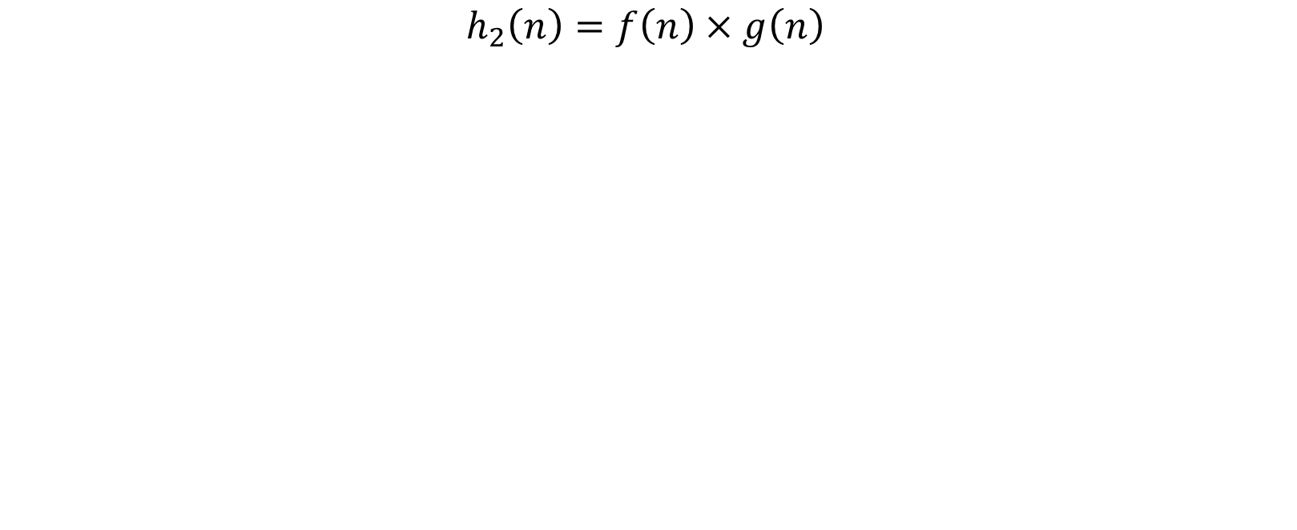
Problem 3: More Asymptotic Analysis!

Slide 48
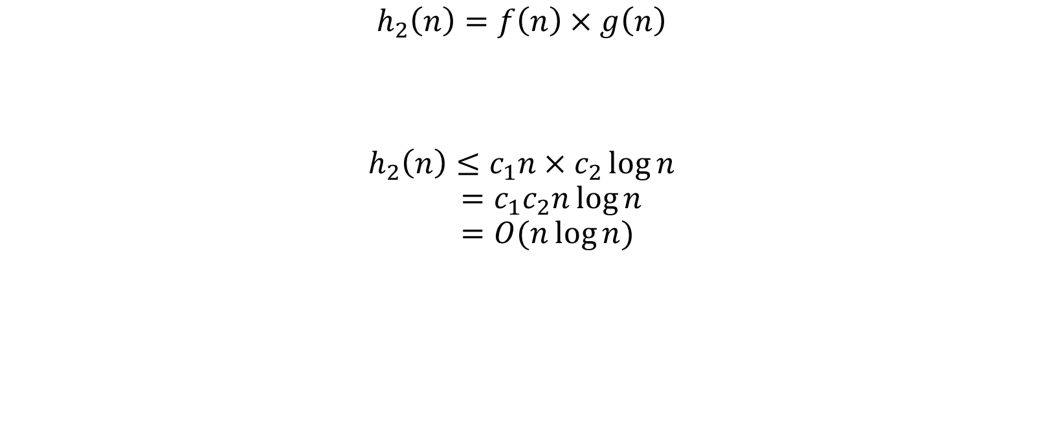
Problem 3: More Asymptotic Analysis!

Slide 49
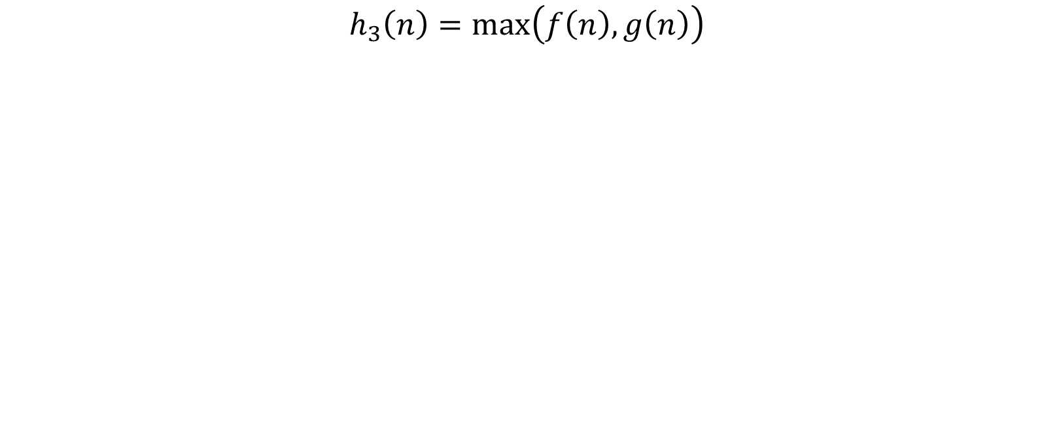
Problem 3: More Asymptotic Analysis!

Slide 50
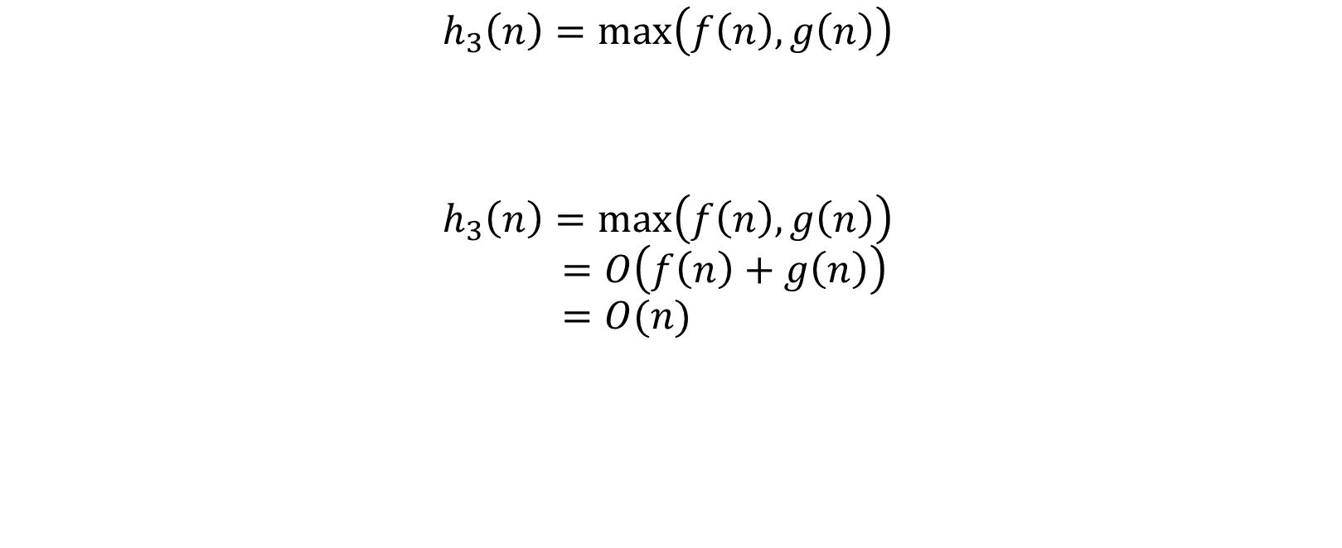
Problem 3: More Asymptotic Analysis!

Slide 51

Problem 3: More Asymptotic Analysis!

Slide 52
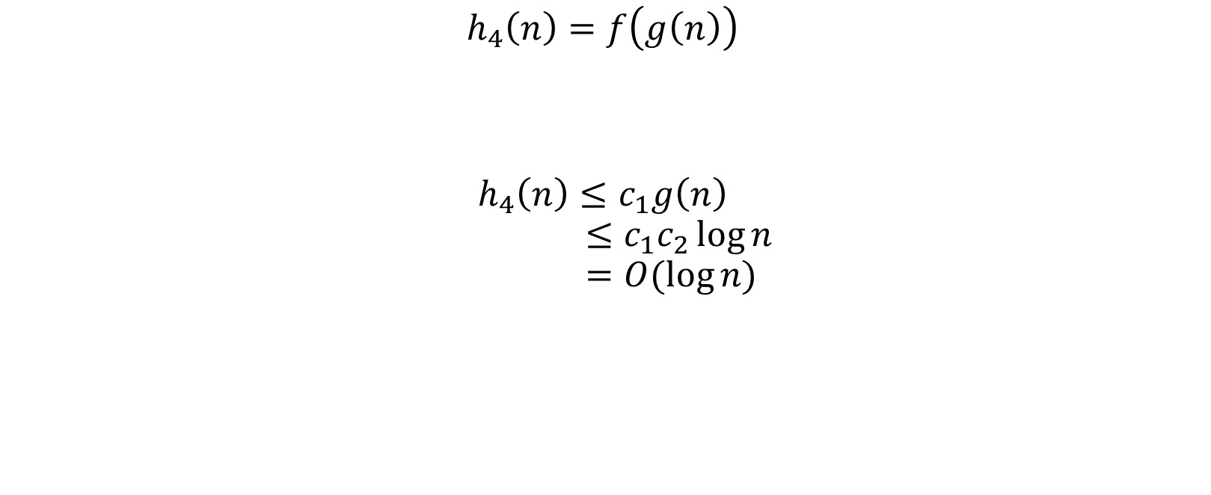
Problem 3: More Asymptotic Analysis!

Slide 53

Problem 3: More Asymptotic Analysis!

Slide 54
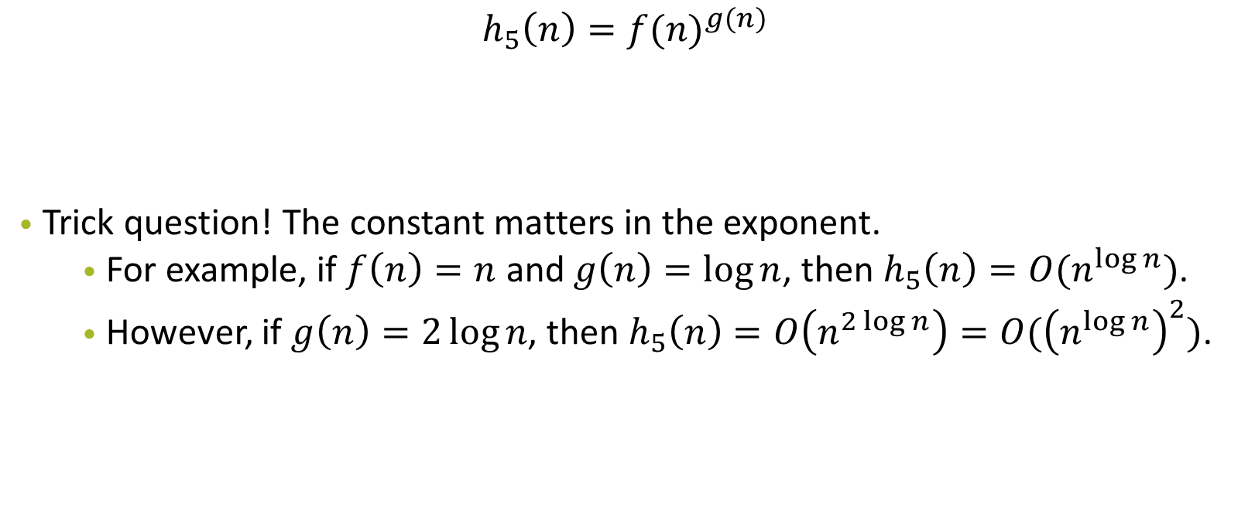
Problem 3: More Asymptotic Analysis!

Slide 55
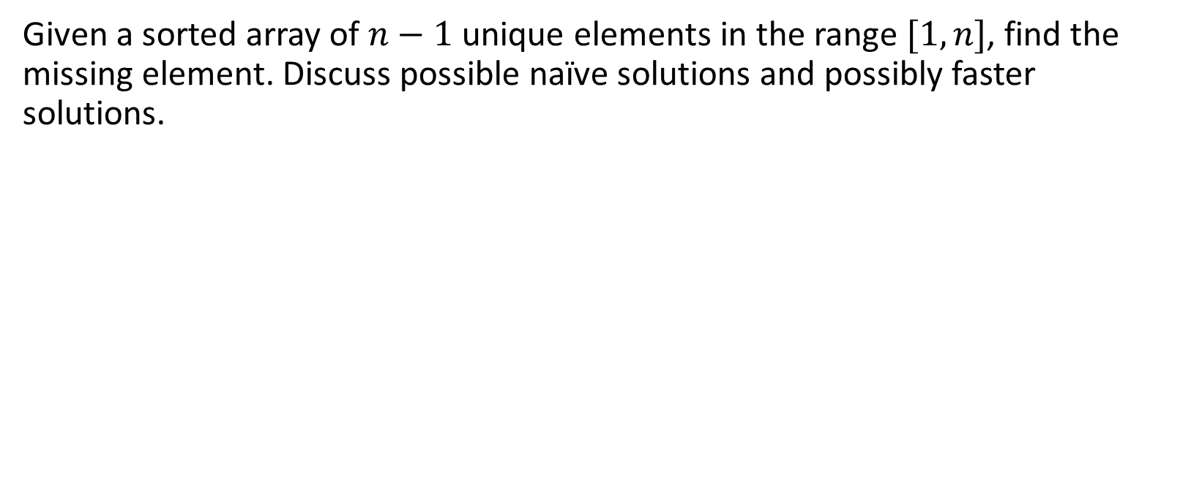
Problem 4: Another Application of Binary Search

Slide 56
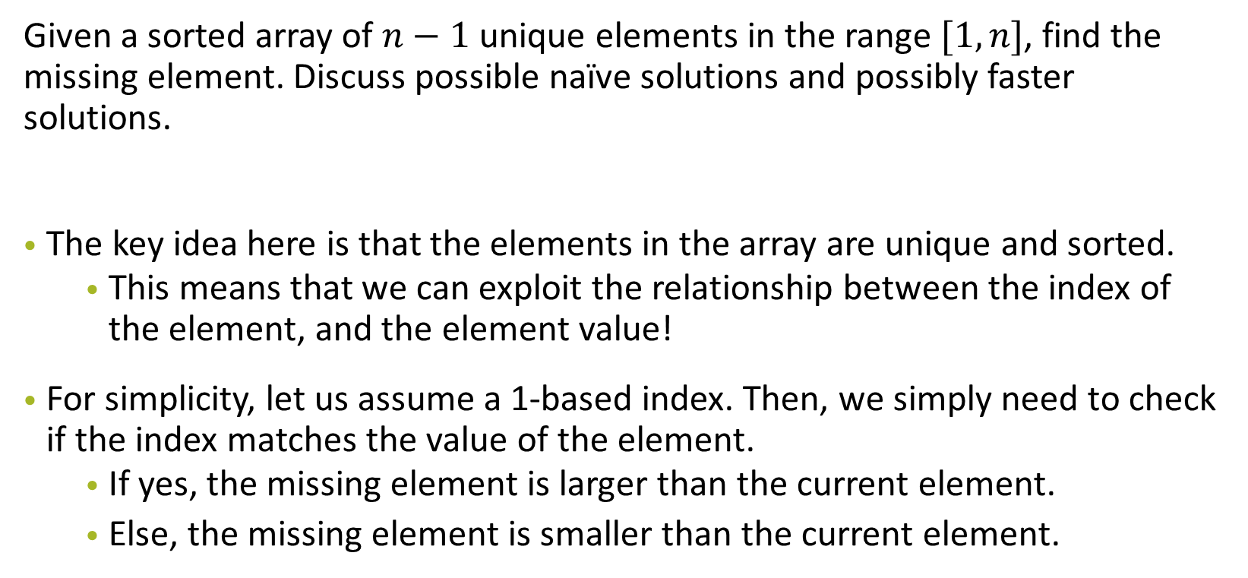
Problem 4: Another Application of Binary Search

Slide 57
Problem 5: Another Application of Binary Search
N piles with piles[i] for i-th pile and h hours remaining
Find minimum rate k to complete the task
During every hour
if pile completed, the remaining time of this hour is spent as well;
else, more hours is needed before you can start on next pile.

Slide 58
Problem 5: Another Application of Binary Search
The key observations include:
Binary Search -> Find monotonic function
When k is getting larger, number of hours to complete task will never increase (monotonically decreasing)
Similar to Tutorial Allocation problem in lecture4
Think about:
Given a fixed k, how to compute the hours?
So solution is to binary search on k
When computed hours is less than h, we search for smaller k
Otherwise, search for larger k

Slide 59
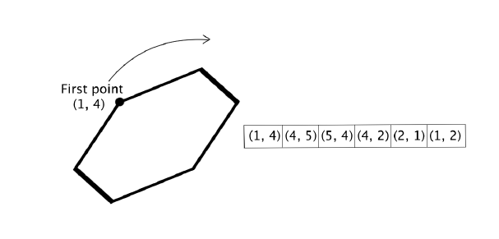
Problem 6 Yet Another Application of Binary Search
Find bounding box

Slide 60
Answer
Find bounding box -> min, max x and y values.
Look for the pattern in the pairs. (aka property of the polygon)
X coords and Y coords can only have 4 graph shapes

Slide 61
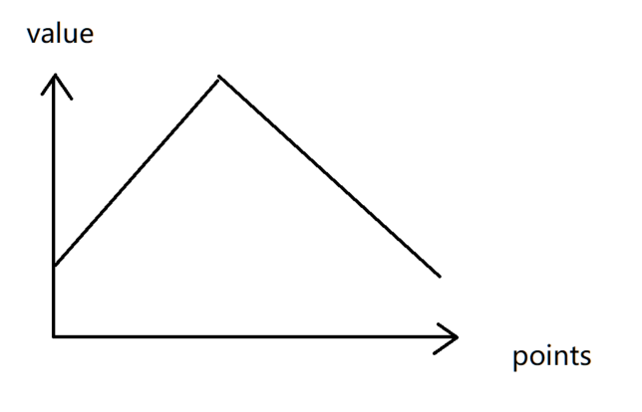
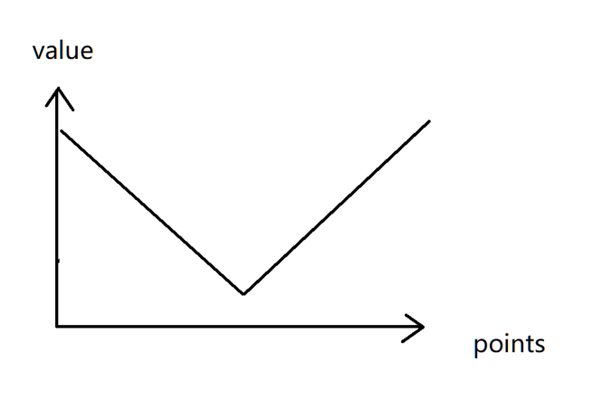
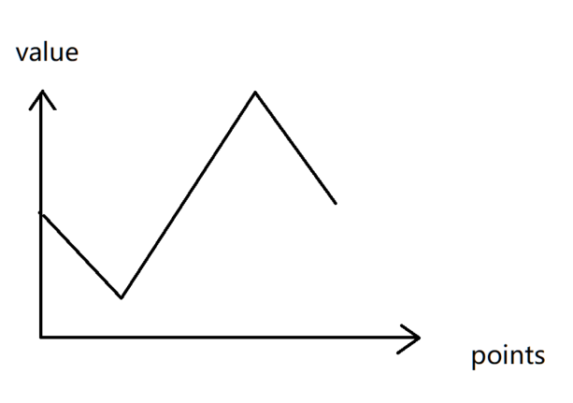
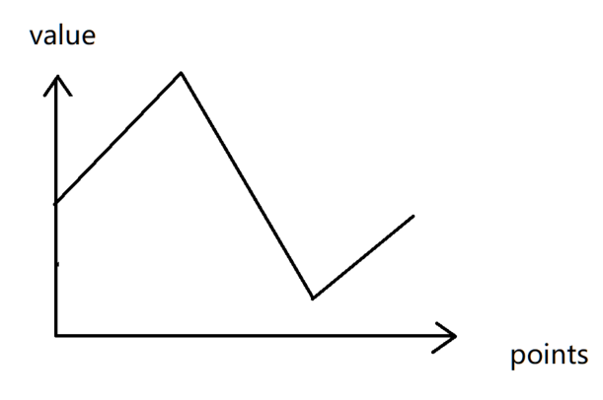
Tutorial Qn 6 Answer

Slide 62
Tutorial Qn 6 Answer
Peak find/ binary search works on those graph. (first 2 is done in ps2)
For the zigzag graph, note that since it is a closed polygon, the start point will not cross once more with the end point.
Therefore, by doing bin search, u can guarantee that the local maximum/minimum -> global maximum/minimum

